Slide 1
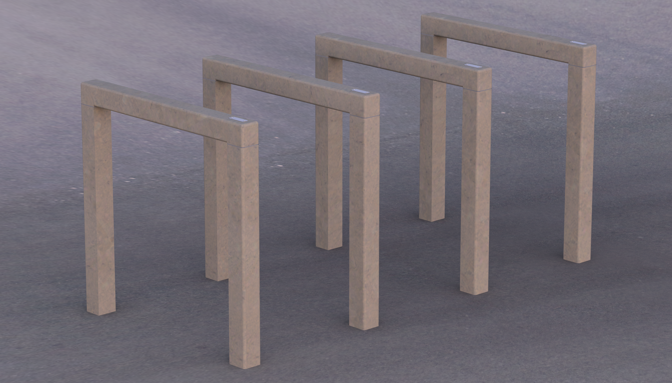


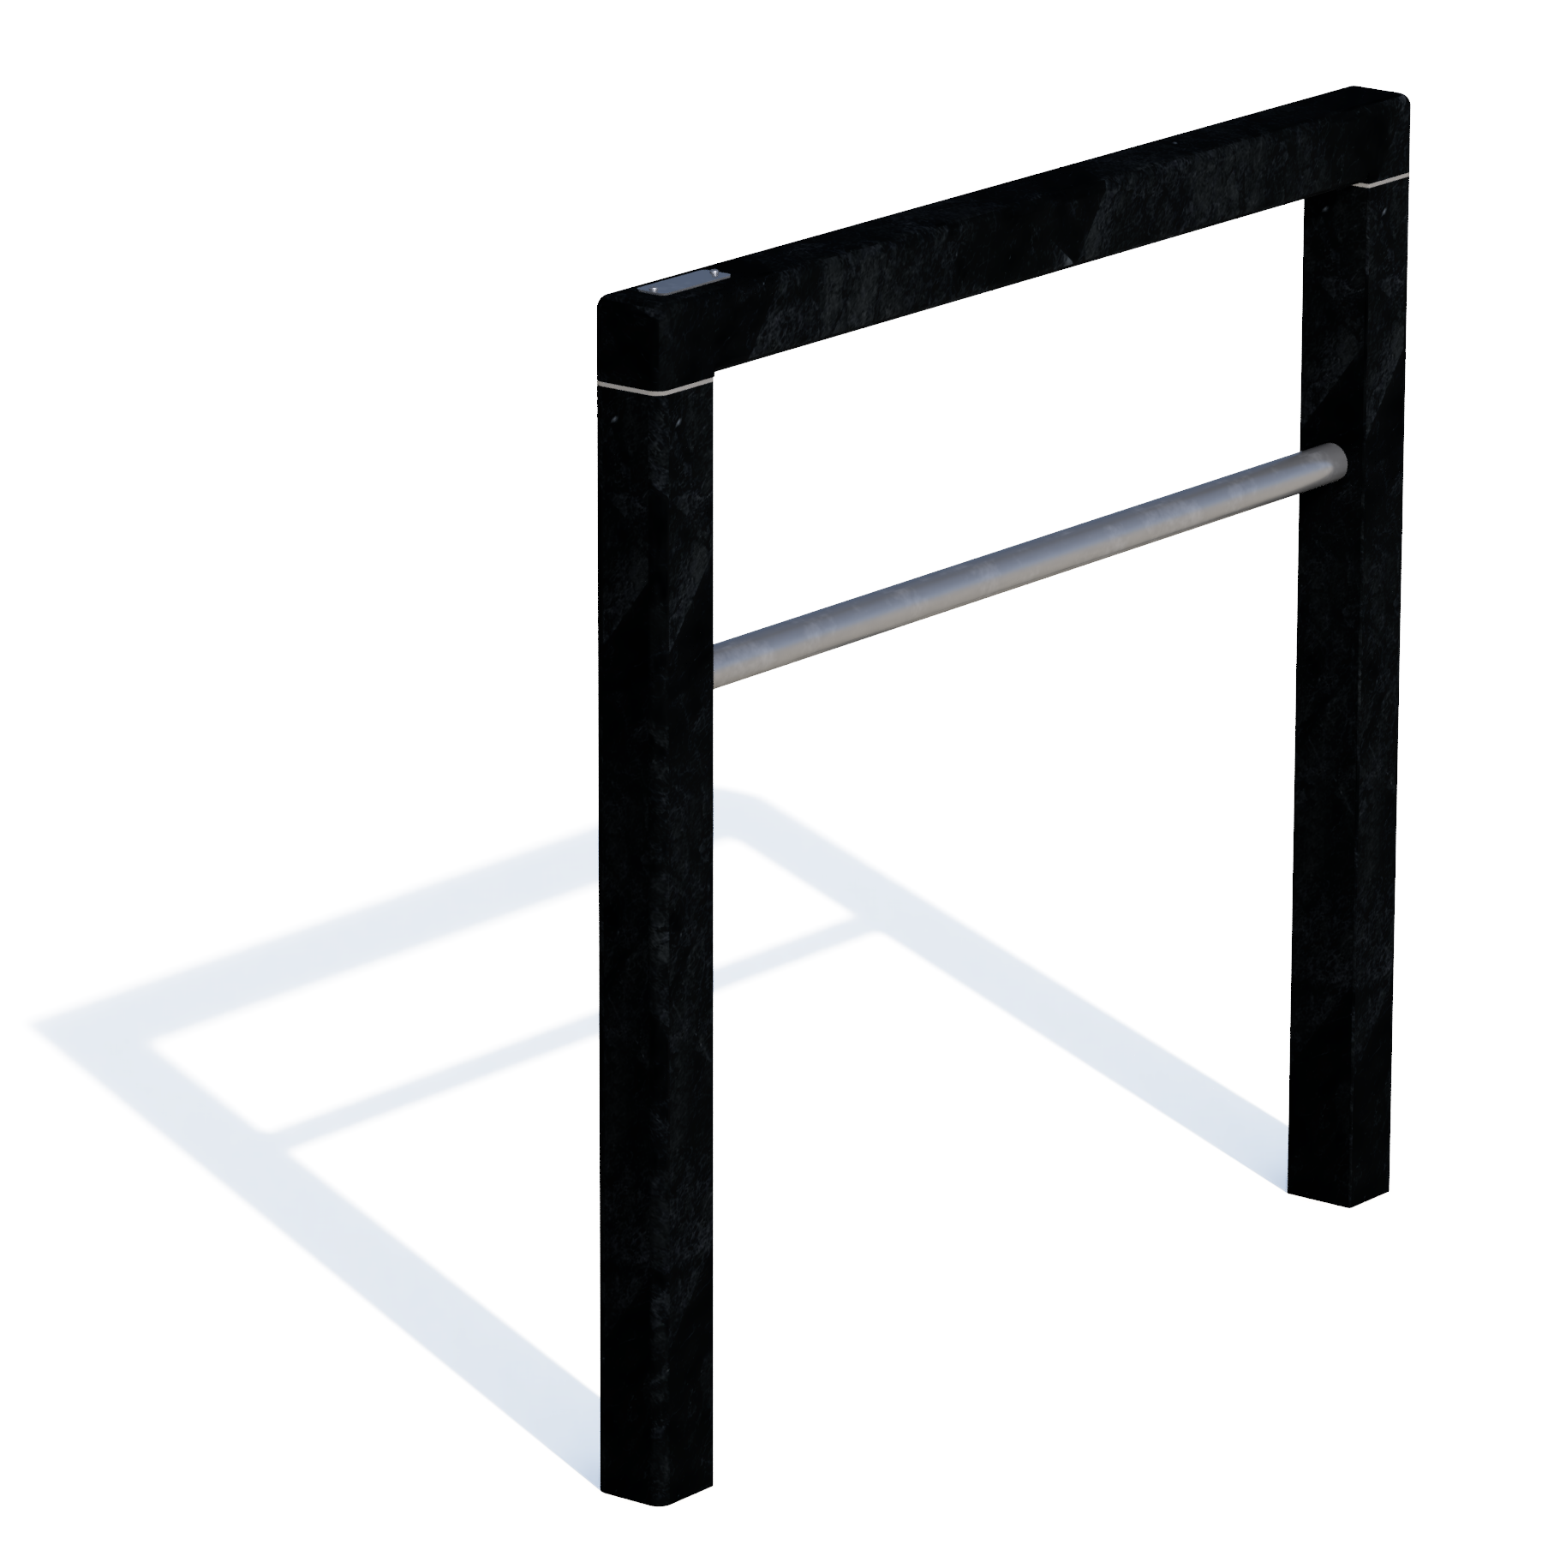

Bicycle stand quare
With or without bar
1 | BIKE STAND – square - technical datasheet 03-02-2025

Slide 2
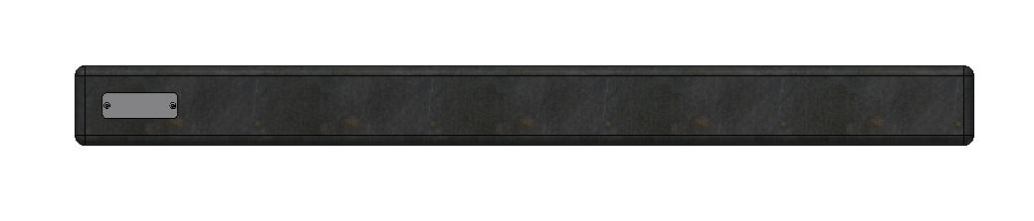
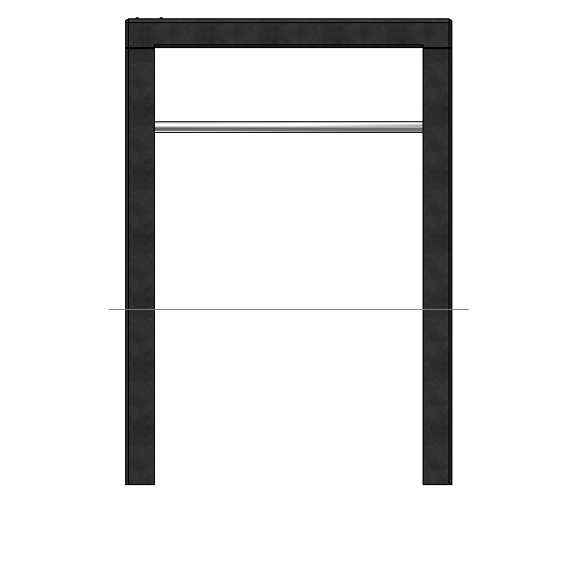
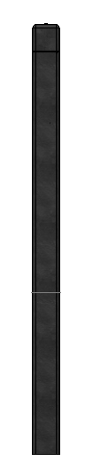
dimensions
6 of 8 cm
90 cm
30 cm
80 cm
ground level
120 cm
40 cm
6 of 8 cm
variations
Thickness 6 cm without stainless steel bar
11,5 kg
Thickness 6 cm with stainless steel bar
12,7 kg
Thickness 8 cm without stainless steel bar
20 kg
Thickness 8 cm with stainless steel bar
21,2 kg
available colours
Ash Grey
Ural Black
Sand Beige
2 | BIKE STAND – square - technical datasheet 03-02-2025

Slide 3
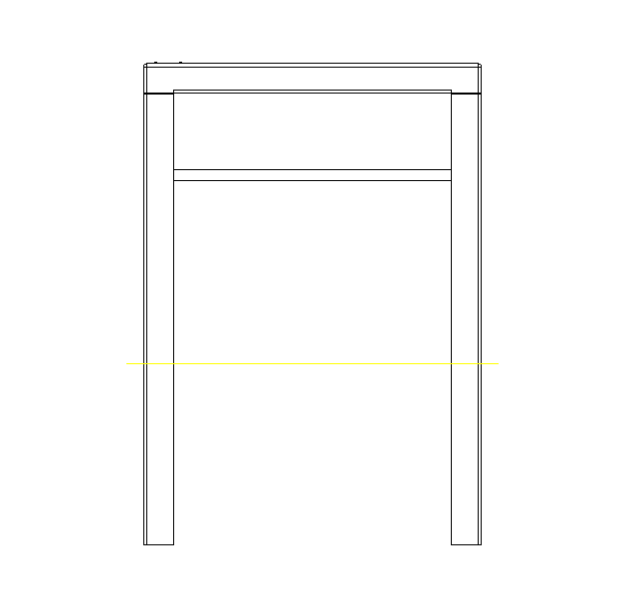
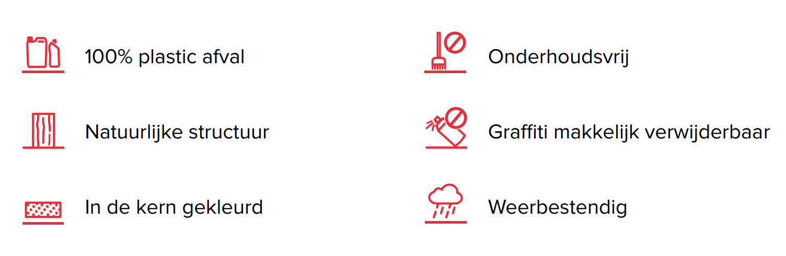
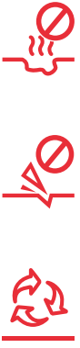
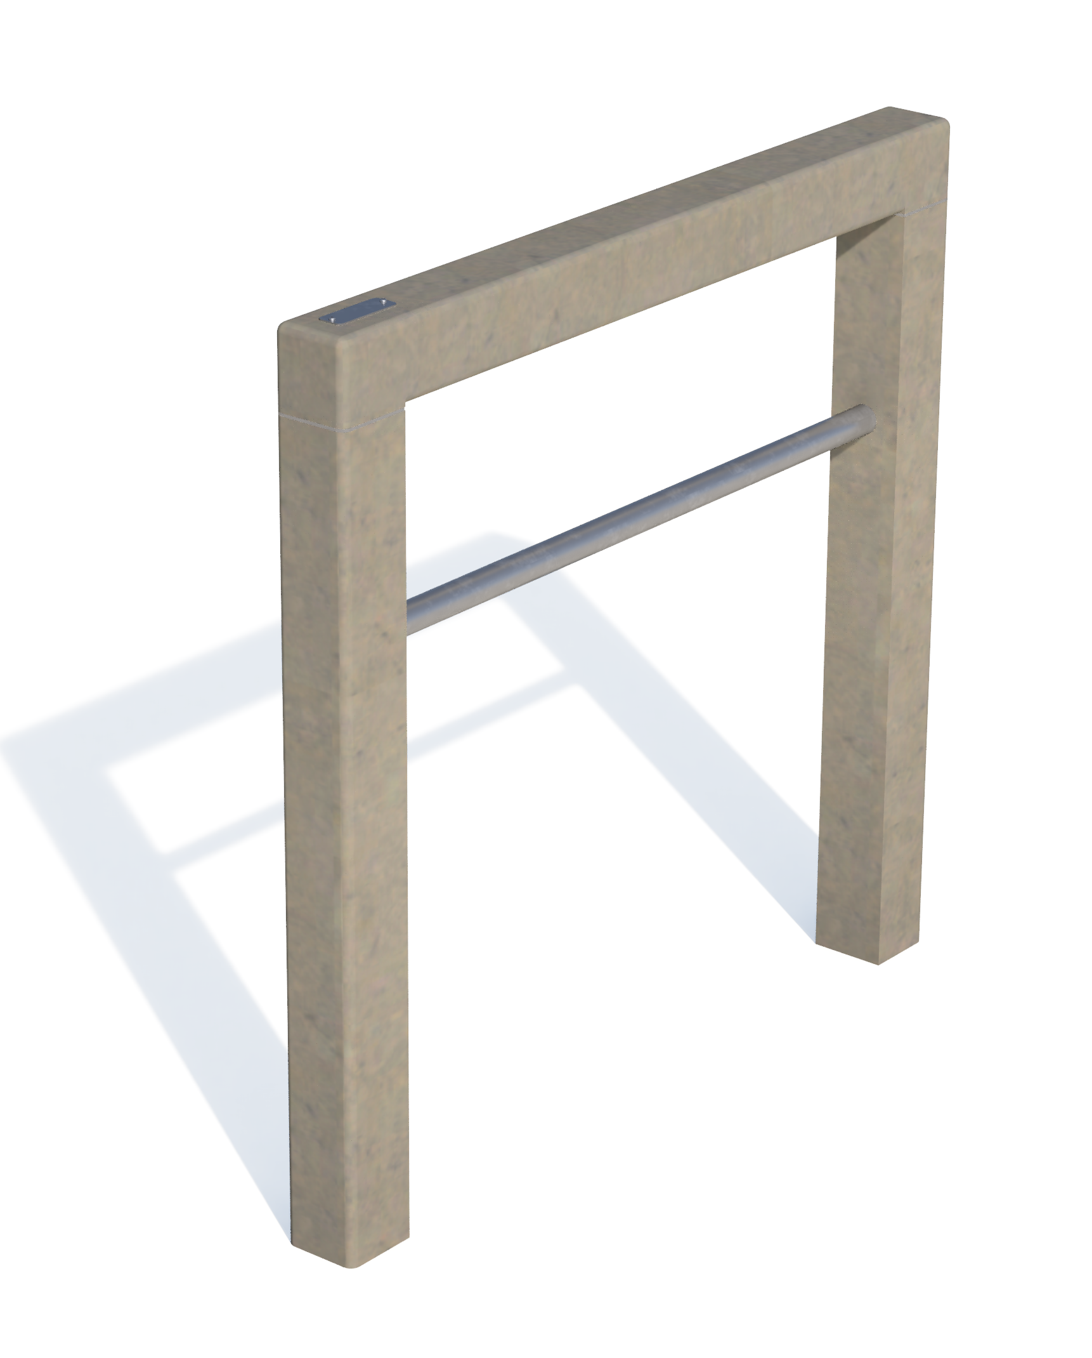
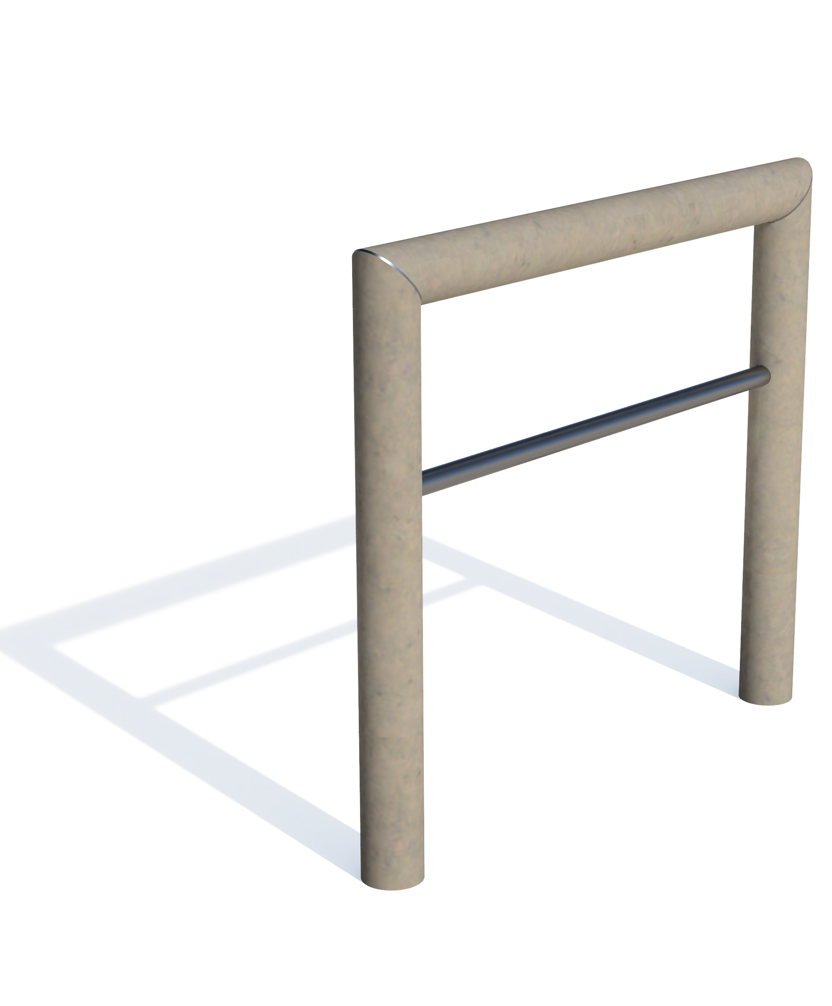
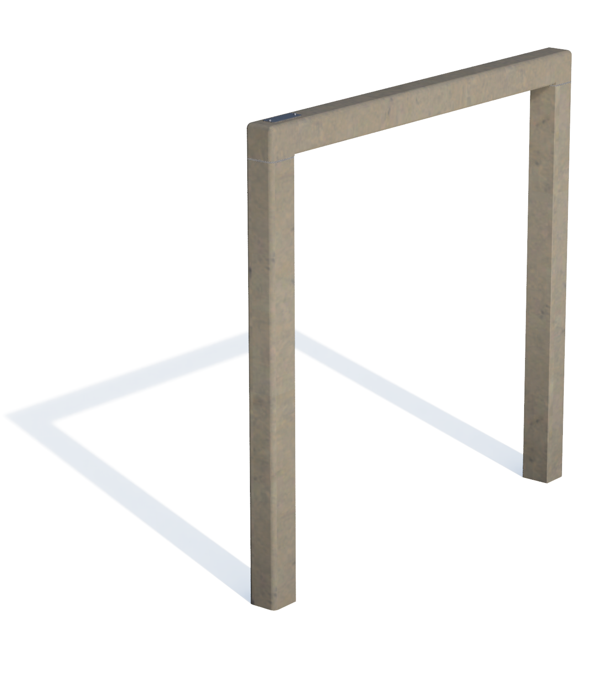
anchoring
80 cm
rapid concrete
ground level
40 cm
main advantages
100% plastic waste
Maintenance friendly
Rotproof
Natural texture
Graffiti resistant
Splinterfree
Coloured throughout
Weatherproof
Completely recyclable
discover the range
3 | BIKE STAND – square - technical datasheet 03-02-2025

Slide 4
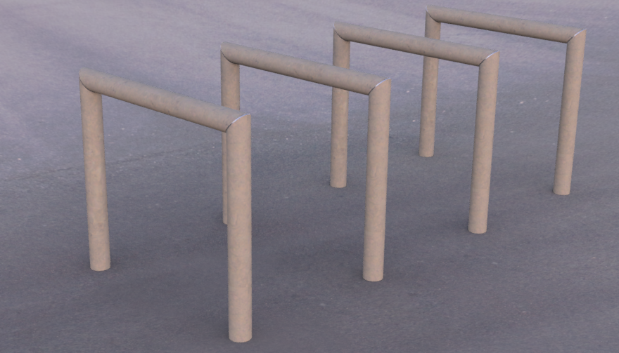
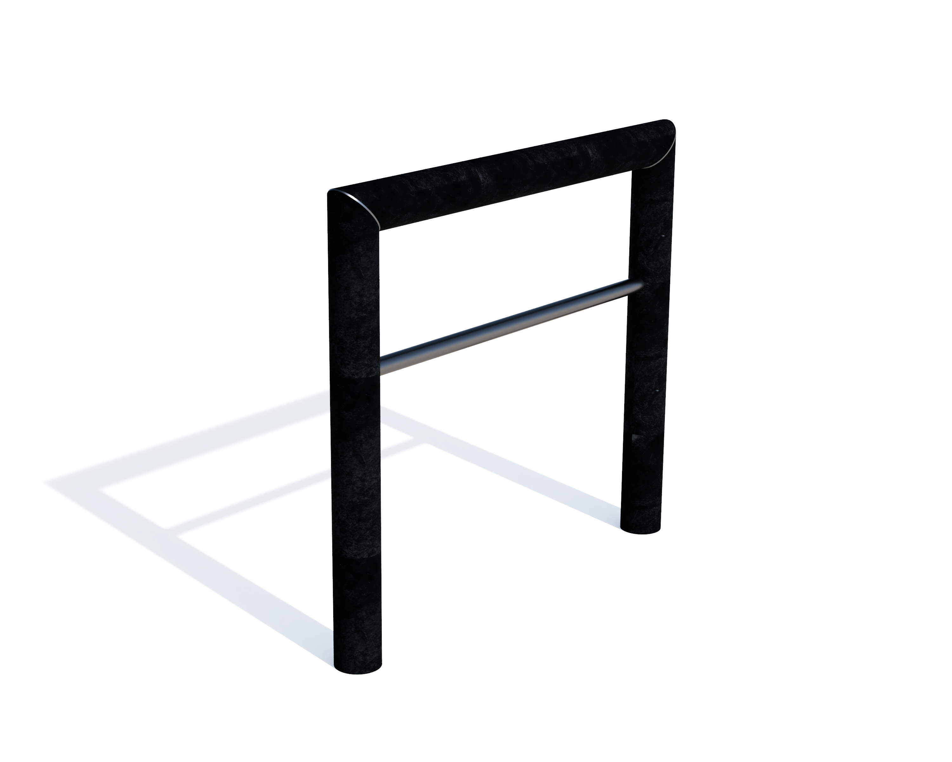
Bicycle stand round
With or without bar
1 | BIKE STAND – round - technical datasheet 03-02-2025

Slide 5
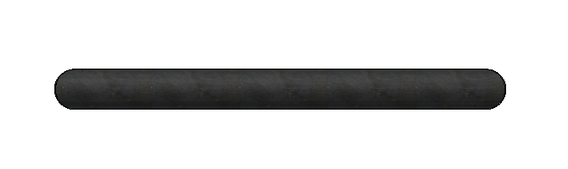
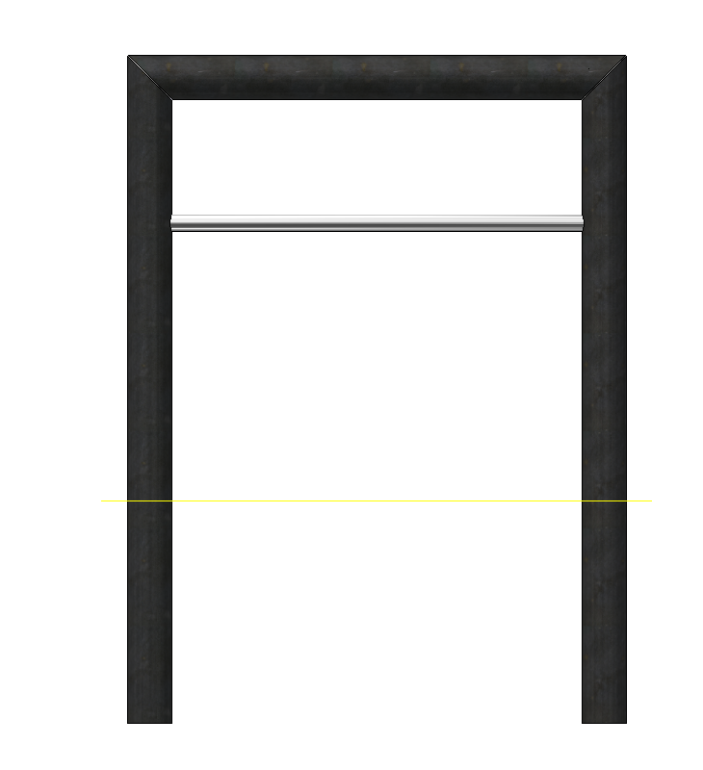
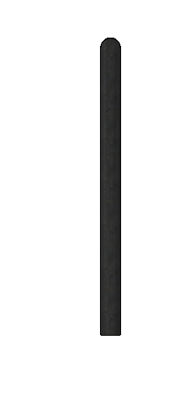
dimensions
Ø 8 cm
90 cm
30 cm
80 cm
120 cm
ground level
40 cm
Ø 8 cm
variations
17 kg
Without stainless steel bar
18,2 kg
With stainless steel bar
available colours
Ash Grey
Ural Black
Sand Beige
2 | BIKE STAND – round - technical datasheet 03-02-2025

Slide 6
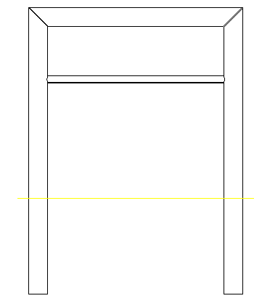
anchoring
80 cm
rapid concrete
ground level
40 cm
main advantages
100% plastic waste
Maintenance friendly
Rotproof
Natural texture
Graffiti resistant
Splinteffree
Coloured throughout
Weatherproof
Completely
recyclable
ontdek het gamma
3 | BIKE STAND – round - technical datasheet 03-02-2025

